Slide 1

Important Tips for Interview
Notes:
This session is designed to provide a map or plan for those who are beginning to search for a new job.
NOTE: Hiring wrong employee is costly. It costs $120 billon to US companies;
Employers are therefore looking for good employees;
Interviews are to verify claims on resume but also to see whether you CAN and WILL do the job;
Secret to successful interviewing is preparation

Slide 2

Interview has 2 parts..
Planning
Presentation.
Notes:
Planning – build a personalized strategy
Practice – helps you put what you want to say right on the tip of your tongue; makes your answers more credible; helps you give complete, clear, concise answers
Give answers that showcase how your skills can benefit the employer
---Planning & Practice improves the odds of getting the job you want.
>Read Chapter 17 – “Preparing for Your Interviews” in your textbook.

Slide 3

preparation
prepare the ground
Notes:
Focus on the advertised position requirements and think of examples from your past that illuminate the required skills and talents
Practice is good – either in the mirror or with a friend
Mock interviews and possibly audio or video taped and use of mirror;
Use “significant other” or friend to practice with;
Put yourself in the right atmosphere and mood, maintain enthusiasm in answering;
Check most frequently asked questions;
Be sure your professional dress elements are ready the day before the interview
Prepare your briefcase the day before;
Go with extra resumes (2 clean and updated copies);
Pens and pencils;
Letters of recommendation;
References;
Extra paper.
PORTFOLIO!
Leave yourself plenty of time to get to the interview site – better to be early than late (hint: it is always a good idea to have an extra dress shirt or blouse ready to go, just in case)
Read the local newspaper the morning of the interview – good for the introductory conversation phase of the interview, and may be useful during the interview to know something about the community
Relax the night before the interview, get some good sleep
Eat a moderate breakfast
Set forth with confidence

Slide 4

Job Description: The Candidate
Candidates for a position should know the job description, match their skills and experience with what is described
Prepare your answers to show how you have experience in each skill area described
(STAR/ZAP METHODS!)
Situation/Task/Action/Result
Zesty/Anecdotal/Presentation
Notes:
Frequently you will not have the job description – in this case study the advertisement or announcement
that prompted you to apply for the position in the first place.
If it was a “word of mouth” notification of some sort, be sure to quiz your source on the opening
As closely as possible about the job duties and responsibilities.
Remember: Employers are seeking candidates with -
- Self discipline;
- Ability to judge about appearances and what is appropriate;
- Someone who can work with others individually;
- Someone who can work with others collectively.
- Not someone who can but will do the job and fit on well at job place;
- Someone with good attitude towards other people;
- By and large: Someone who matches skills needed and company culture.
PORTFOLIO
Writing samples,
Graphic design samples,
Video tapes etc.;
Bring only the most important items with you.

Slide 5
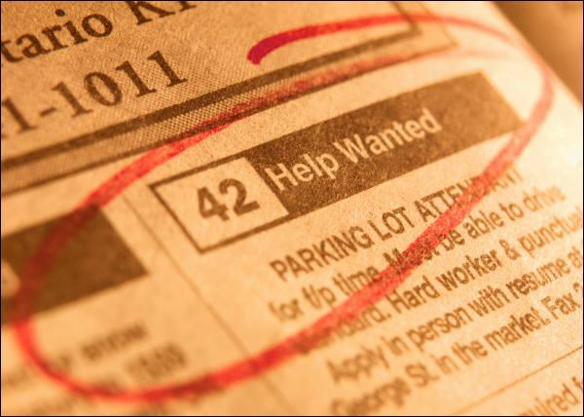
Job Description: An exercise
OLD NATIONAL BANK-RETAIL CENTER, ASSISTANT MGR: Assist manager in managing sales & daily operations of center including inside sales, financial profiling, teller transactions, customer service, general operations, and personnel. Develop new & enhance existing relationships with customers by offering products & services to meet their financial needs. Requires excellent supervisory, interpersonal, problem solving, communication, and customer service skills. Strong knowledge of operational policies and procedures is required.
STAFF ACCOUNTANT: Full-time career opportunity for a Staff Accountant. This position requires a detail-oriented person who enjoys performing a variety of tasks. QuickBooks experience a plus. Duties will include monthly journal entries and reconciliations, accounts receivable, accounts payable, and assistance with month-end close. Requires four-year accounting degree and 1-2 years experience.
INSTRUCTIONS: 1) Circle required skills,
underline desired skills and experience.
2) Prepare at least 6 interview questions.
Notes:
>PRESENTER: You will want to pass out the Exercise Sheet (a copy of this slide will do) as you begin this exercise.
Once audience has completed analysis of ads, go on to next slide.

Slide 6

Job Skills Needed
Technical skills-computer skills, computation skills, physical skills
Performance Skills-communication skills, problem solving skills
Interviewer:
BASE YOUR QUESTIONS ON FINDING OUT HOW THE CANDIDATE HAS DEMONSTRATED THESE SKILLS IN THE PAST.
Candidate:
YOUR PROSPECTIVE ANSWERS SHOULD TAKE INTO ACCOUNT DEMOSTRATING HOW YOU USED THE APPROPRIATE SKILLS IN TO BE SUCCESSFUL IN THE PAST
Notes:
Use copy of job description. Want to talk to someone in the organization who is doing the job and is good at it. Come up with a list of skills then write behavior-based questions based on the skills needed.

Slide 7
INSTRUCTIONS: 1) Circle required skills,
underline desired skills and experience
STAFF ACCOUNTANT : Full-time career opportunity for a Staff Accountant. This position requires a detail-oriented person who enjoys performing a variety of tasks. QuickBooks experience a plus. Duties will include monthly journal entries and reconciliations, accounts receivable, accounts payable, and assistance with month-end close. Requires four-year accounting degree and 1-2 years experience.
Notes:
What does this tell you? What kind of skills are needed? Let’s start with technical skills. How about performance skills? If a manager, what kinds of questions would you ask to get at those skills. Use Roche job descriptions.
Do you need more information than this to prepare to interview new candidates. Yes and how can you get this information. Talk to the person currently in the position. Talk to people who work directly with this person to see what skills they think are important.

Slide 8
INSTRUCTIONS: 1) Circle required skills,
underline desired skills and experience
OLD NATIONAL BANK-RETAIL CENTER, ASSISTANT MGR: Assist manager in managing sales & daily operations of center including inside sales, financial profiling, teller transactions, customer service, general operations, and personnel. Develop new & enhance existing relationships with customers by offering products & services to meet their financial needs. Requires excellent supervisory, interpersonal, problem solving, communication, and customer service skills. Strong knowledge of operational policies and procedures is required.
Notes:
Let’s share some of the questions you came up with. So we decide on 10-12 good questions whose skills we need match the skills asked about in the questions, and now we are ready to interview. How many candidates should we interview? Screen a lot but typically 5 candidates for one position is about right.

Slide 9
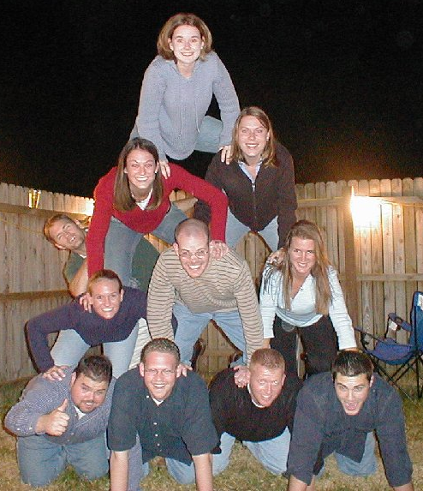
Use Your Advocate Network
..to review, prepare, practice
People in Key positions
People who support you
Friends, acquaintances
Notes:
Different people in Key positions;
a person on the selection team who can sway the decision in favor of hiring you.
Anyone who would support you in a credible way;
a person who knows your skills & character.
Person who can describe what you can do for the organization.

Slide 10
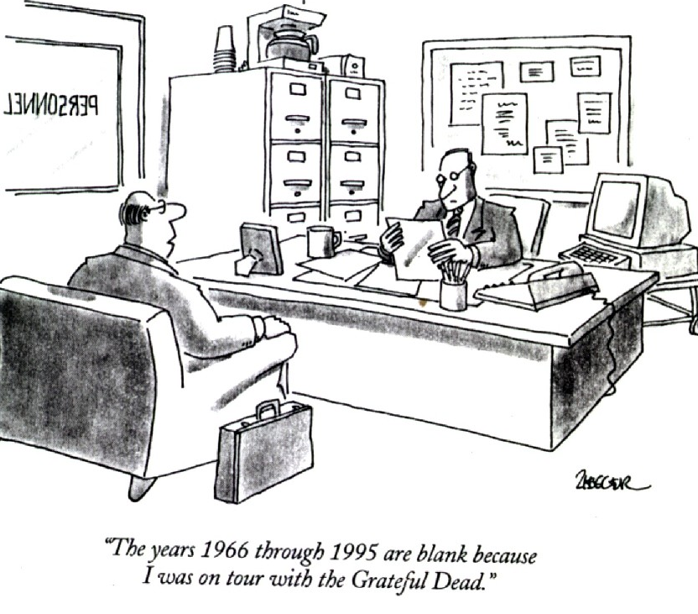
Review
Profile Skills
Skill/Benefit Statements
STAR Model
Advocate Network
Positioning Statement
Follow-Up
Keep search active

Slide 11

The Interview
Positive first impression
Skill/Benefit statement
Sprinkle benefits
STAR model
(more on that later!)
Notes:
Begin the interview effectively:
Positive 1st impression: non-verbal messages: dress appropriately, stand tall, hands away from your face, positive gestures, smile.
Positioning statement: interviewer’s name, appreciation for interview, indication that you’re ready to engage in productive interview. Shows that you appreciate the interview opportunity while reinforcing the fact that you are confident & prepared.
Skill/Benefit statement
Sprinkle benefits throughout the interview
Small classroom Role-playing: Divide students into pairs, give out interview questions handout from textbook, students role-play interview situation, then switch places. Give ~20 min.

Slide 12
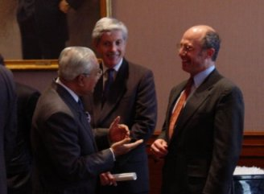
establish rapport
a few minutes of “small talk”
Notes:
Initially, a few minutes of sociable conversation “breaks the ice”
Every interviewer should expect a job applicant to be a little nervous, and will seek to establish a more amenable atmosphere – this is not an interrogation
You will help yourself by smiling, seeming at ease, discussing things like the artwork in the waiting room or lobby, the weather, etc.
Remember, one of the goals of an interview is to see if you will fit in with the organization – are you someone with whom the interviewer will be willing to spend the work day?

Slide 13
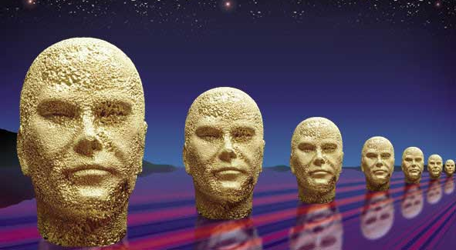
Interview Questions: The Candidate
Interviewees should prepare for the interview
  writing a list of 10 anticipated questions and answers
  rehearsing answers that highlight their experiences that match well with the skills needed
Distinguish yourself!

Slide 14
Possible Questions
INSTRUCTIONS: 2) Prepare at least 6 interview questions.
Tell me about a time when you had to be very detail-oriented to complete a project well. How did you organize yourself to complete the task? What were the results?
What kind of experience do you have working with month-end closes? What techniques do you use to make sure the close goes smoothly? What are the results?

Slide 15

future behavior on the job can be anticipated by previous behavior
interviewers target questions
zeroing in on your past actions
Notes:
The theory behind behavior or performance interviewing is simple: the candidate’s past behavior can predict how they will behave in the future
This is fast becoming the most popular form of job interview technique, because it works as long as
Interviewers use the same set of questions for each candidate ( be prepared for between ten and twenty questions depending on the time available)
The interviewer has questions that reflect on the essential skill areas of the position being discussed (hint: these will often be outlined in the advertisement for the position)

Slide 16


ZAP ‘em with a STAR
….tell them a story that illuminates
transferable skills….
Situation
Task
Results
Actions

Slide 17
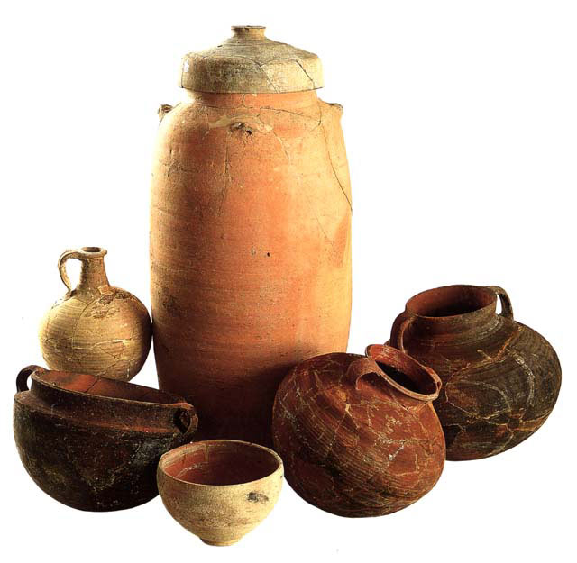
past behavior = future behavior
specific examples!
Notes:
The interviewer’s questions in a behavior interview are usually meant to elicit concrete examples of how you acted in various types of situations in the past
Even if the interviewer speaks in more general terms, it is a good idea to make at least passing reference to specifics that illuminate your qualities

Slide 18
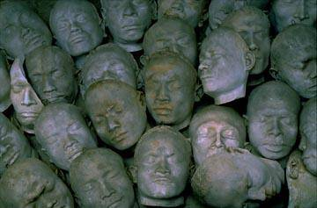
there’s always a crowd of candidates…
….how can you stand out
as the best choice?

Slide 19

Z.A.P. ‘em…
Zesty Anecdotal Presentation
Notes:
Ref. p. 445, Career Planning Today
Rather than describe a boring event in your life in response to an interviewer’s question, you must spice up the anecdote taken from class, home or work
But be sure that it highlights a desired quality – initiative, people-skills, leadership, etc.
One of the best types of Z.A.P.s is the humorous incident that partakes of a common problem or experience, shows how you solved or helped resolve the issue, AND demonstrates what you learned from the incident (a skill, attitude, etc. that will be an asset to any employer)
It is a good idea to have one or two of these Z.A.Ps ready to use as appropriate interview circumstances or questions occur.
As in developing other interview techniques, brainstorm and practice-practice-practice with your friends and relatives to develop a repertoire of interview skills and Z.A.Ps

Slide 20

through a glass darkly
help the interviewer see you clearly
Notes:
Specific examples of how you acted in the past help the interviewer get a clearer picture of how you’ll act in the future
Use the opportunity to project your personality and “can do” attitude
Of course, your examples should show you in the most business-like light possible, but also try to show a sense of humor, a balanced approach to life, and a sense of proportion
Remember – during the interview they’re asking questions to illuminate your skills and knowledge with relation to the major elements of the job, BUT they’re also judging how you’ll be to work with every day
Have a clear idea of the necessary and preferred qualities ( from the job ad, your research, etc.)
Relax! If you can enjoy the interview and help the interviewer enjoy it, you’re halfway home

Slide 21

ZAP ‘em no matter what
Zesty
Anecdotal
Presentation
Notes:
Always try to ZAP the interviewer.
By phrasing your answers to interview questions with interesting, or humorous, or unusual stories from your own experience (or even about situations you have witnessed rather than participated in) you will make your answers and your presence stand out from other, more mundane or bland candidates.
It is an excellent idea to have a small repertoire of STAR/SHARE stories that you can use during interview situations, well-rehearsed and ready.

Slide 22


silence is golden
use it to your advantage….
Notes:
Interviewers may occasionally ask questions for which you have no immediate answer or example
Don’t panic, say something like, “That’s a good question, let me think for a moment”
Stay calm
This is that moment for which you have (hopefully) prepared one or two more “generic” STARs that can be applied ( a “learning experience” story, a “customer service” experience, etc.)
But don’t waste this transient moment of silence – make it yours and use it.
Displaying composure in these situations is a plus
A good interviewer will know these moments of silence are not uncommon and may reassure you about this
Occasionally an interviewer will be testing you to see how you behave under the pressure of silence
Use the moments of silence to compose a good answer
Start out your reply by restating the question
If, after a few minutes, you have just drawn a blank, say something like “That particular situation has not yet occurred to me, but…” and relate an anecdote that will provide a positive response and is similar in nature (“ZAP ‘em” if you can)
Sometimes you just have to pass on a question – but remember, all experience is worthwhile and non-job related anecdotes will work too

Slide 23

contrarian strategy
interviewers often probe to get a negative view
allude to minor negatives in your answers to avoid this
Notes:
Wanting to avoid an unbalanced, Pollyanna-like view of the candidate will often lead interviewers into latching onto possible negatives in
Your answers
What you don’t say
The “contrarian’s strategy” consists of acknowledging minor negatives in a few answers (“ Well, the result was that we had to stretch procedure and policy a bit to make the customer happy, but our manager understood the need for flexibility in that unusual situation”, etc.) to forestall too much focus on the negative
Be careful! Don’t overdo this.

Slide 24
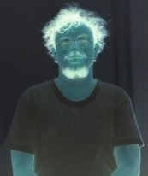
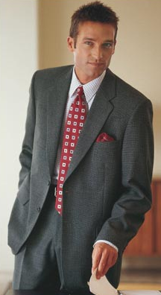
sometimes they just go negative
leverage this to your advantage
Notes:
Be prepared -- you will probably get questions like, “Give me an example of a mistake you made in handling a difficult colleague/customer/boss, etc.”
In these cases, ALWAYS stress a positive result or lesson learned from this negative
Don’t be TOO clever, but answers like “ I tend to focus on getting all the details just perfect.”, or “I’ve been accused of being a workaholic”, show both negative and positive elements. Being detail-oriented or putting in extra work on a project are not necessarily all bad from the employer’s point of view!

Slide 25
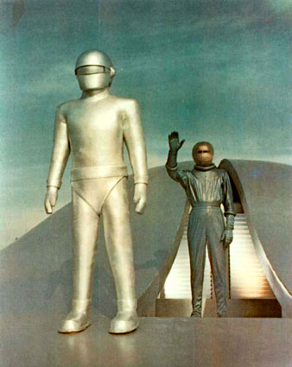
Strange Questions?
Be honest
Use Skill/Benefit statements
Use STAR Model
“Klaatoo, barada niktoe”
Notes:
Killer questions like: Why is the sky blue?
Answer: I don’t know why the sky is blue, but I can. . . , so that . . . (Skill/Benefit statement)
Adopt a general strategy: Use specific skills benefits statements and prepare SHARE model answers for general questions and for each answer.
Use SHARE model whenever possible to give examples of problem solving skills
Use every question to provide information about yourself & what you can do for the organization
If question insults your dignity, do you really want to work there?
Example: tape count 14.65 – 15.47 or use handout.

Slide 26
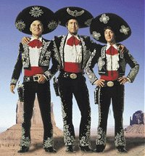
The Big Three……
There are three questions that seem to be the most difficult to answer…..
“Tell us about yourself.”
“Describe your weaknesses.”
“Tell us about a mistake you have made.”

Slide 27
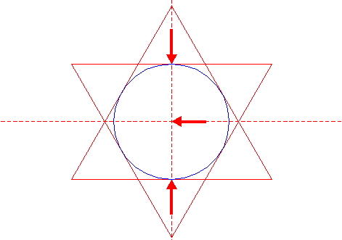
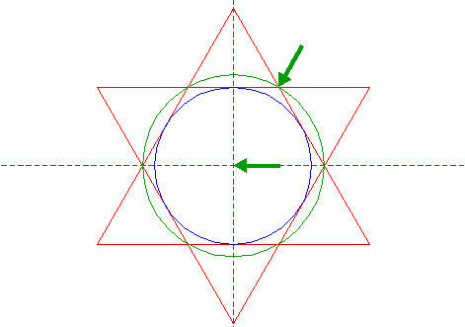

Tell them about yourself and pre-empt….
If you get the generic “Tell us about yourself” question early in the interview – use it to pre-empt later focus on the negative.
construct a great STAR
Notes:
By building and practicing a textured STAR answer aimed at giving the interviewer some insight into who you are, you can incorporate “weakness” and “mistake” anecdotes that act to your advantage as well as perhaps pre-empting later negative-focus questions.

Slide 28

Terminated?
Do not volunteer this information, but if asked -
Explain circumstances
Be honest
Never derogate your former employer
(but not in too much detail,
for example: “new management took over”)
(but circumspect, for example:
“the new supervisor and I did not see eye to eye”)
(be discreet, for example: “ I was not a good fit with
the new company culture”)

Slide 29
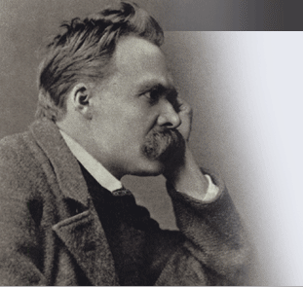
“That which doesn’t kill us makes us stronger.”
In response to a “weakness” or “mistake” question, ALWAYS address the lessons or skills you learned….
Notes:
Friedrich Nietzsche quote….more or less….

Slide 30
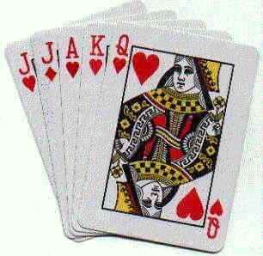
current behavior = future behavior
your interview IS you – will you “fit”?
Notes:
A ever-present undercurrent of many behavior interviews is how your presence and manner effect the interviewer at the time – everyone has “gut feelings” that arise from the current interactions
Many times the interviewer will NOT be a human resource professional, but someone you will directly work for or work with
No matter how “good” your answers are, how you come across in the interview itself is important too
Always look the questioner honestly in the eye while answering
In group interviews, start out answering the questioner directly, move your attention and gaze to include the whole “panel”, and finish up with your frank gaze back upon the original questioner
Don’t be afraid to ask for clarification of a question – most will appreciate your desire for clarity
Mind your manners, kiddo!

Slide 31

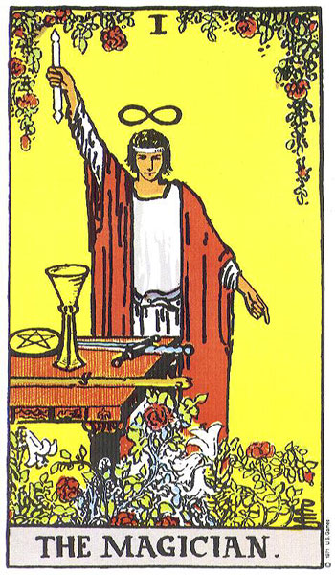
Will you be the office fool?...
….the magician?...
Notes:
Are they going to want to see you and work with you eight hours a day, every work day?

Slide 32

Who are you…you, you, you, you?
they really wanna’ know….
Notes:
Openness, honesty, humor, flexibility, integrity – use the behavior interview to your advantage to bring across these pleasing aspects of your personality
Try to introduce some things that are unique about yourself – a hobby, an experience, etc. – that will differentiate YOU from the other candidates
Be serious but NOT ponderous.

Slide 33
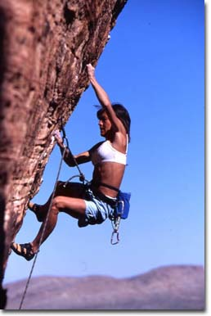
if the going gets tough
hang in there….
Notes:
Remember, all interviews are stressful. The interviewer knows this.
If you seem to be stumbling, or feel like you are doing poorly, pause a minute and regroup internally.
Keep your cool, don’t rush

Slide 34


Follow-Up
Thank you letter
Check with Advocate Network
Keep looking for opportunities
Notes:
Thank you letter that reinforces that you are the best candidate for the position.
Keep checking with your Advocate Network & add people.
Even if everything looks good, keep search active

Slide 35

the gestalt
professional look and manner
real examples of past behavior
actions and words in the interview
Notes:
EVERYTHING contributes to the composite image of you the interviewer is left with
How you are dressed (business professional)
The examples you provide of past actions, both negative and positive
How you act in the interview
Composure
Dealing with silence
Projection of personality
Grace under pressure

Slide 36

success
Notes:
During the arduous job hunt process you will be “unsuccessful” 99% of the time in landing a job
That 1% “success rate” is all you really need – because you only need one job at a time!

Slide 37

EVALUATION
QUESTIONS
Discussion #27
USE:
a. Strongly Agree
b. Agree
c. Disagree
d. Strongly Disagree
e. Don’t Know
I found the presentation material easy to
understand.
2. This Advantage session increased my knowledge on the subject presented.
3. I will be able to use some of the information
from this Advantage session in the future.
4. The presenter was well prepared for this session.
5. This presentation should be repeated in future semesters.

